Slide 1
Some Continuous Probability Distributions
Chapter 6

Slide 2
Chapter 6
Similar to what we did in chapter 5, chapter 6 goes into detail with some specific continuous distributions.
6.1 begins with perhaps the simplest distribution, the uniform distribution. Then 6.2-6.4 deal with the normal distribution. We will finish the chapter in 6.6 discussing the gamma and exponential distributions.

Slide 3
6.1 – Continuous Uniform Distribution
While perhaps too simple to have many applications, the uniform distribution is a good place for us to start working with continuous distributions.

Slide 4
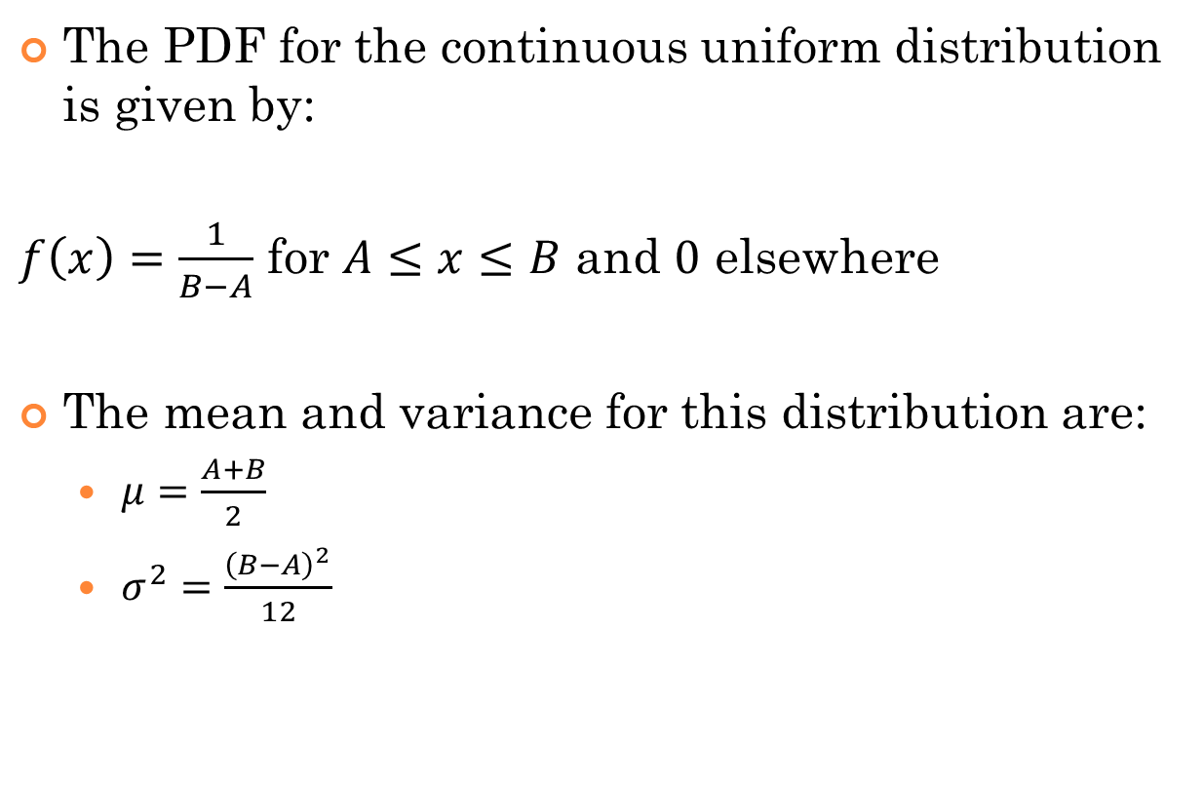
6.1 – Continuous Uniform Distribution
The PDF for the continuous uniform distribution is given by:
$f\left(x\right)=\frac{1}{B−A}$ for $A≤x≤B$ and $0$ elsewhere
The mean and variance for this distribution are:
  $μ=\frac{A+B}{2}$
  $σ^{2}=\frac{{\left(B−A\right)}^{2}}{12}$

Slide 5
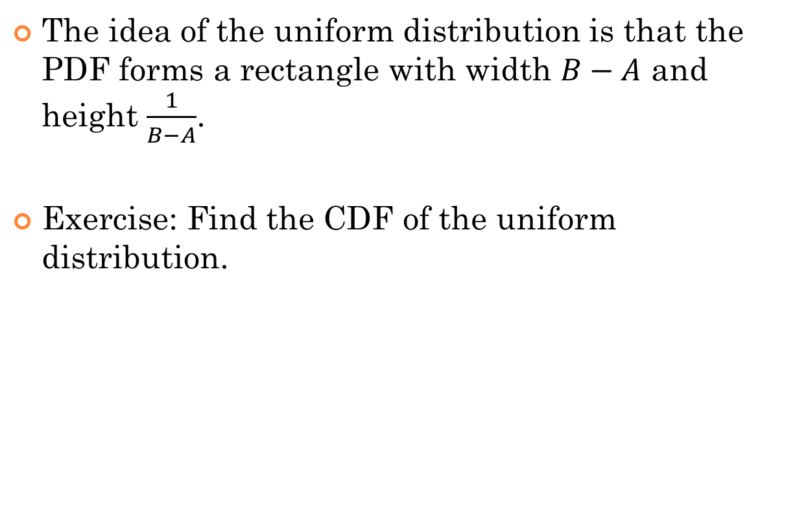
6.1 – Continuous Uniform Distribution
The idea of the uniform distribution is that the PDF forms a rectangle with width $B−A$ and height $\frac{1}{B−A}$.
Exercise: Find the CDF of the uniform distribution.

Slide 6
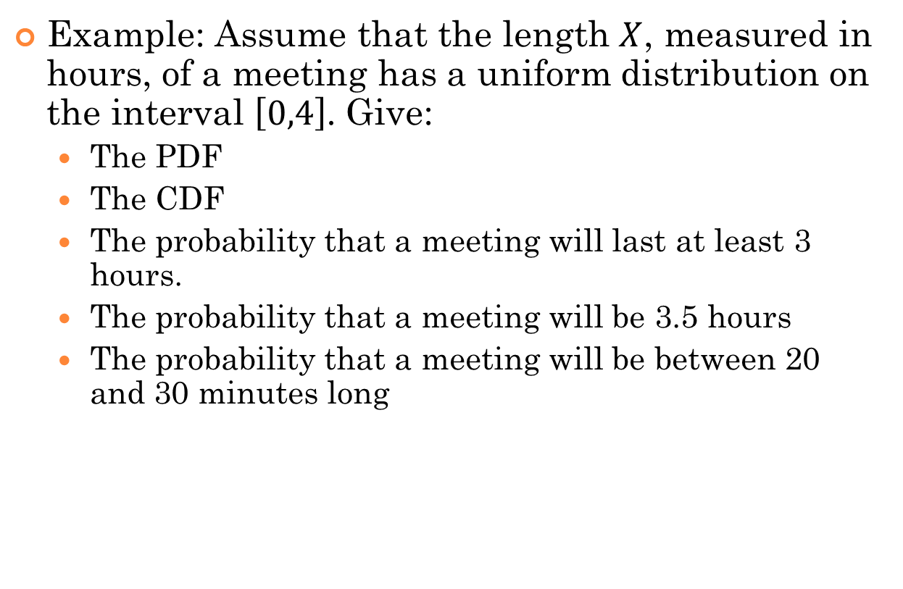
6.1 – Continuous Uniform Distribution
Example: Assume that the length $X$, measured in hours, of a meeting has a uniform distribution on the interval $\left[0,4\right]$. Give:
  The PDF
  The CDF
  The probability that a meeting will last at least 3 hours.
  The probability that a meeting will be 3.5 hours
  The probability that a meeting will be between 20 and 30 minutes long

Slide 7
6.2 – Normal Distribution
We now move on to what may be the most important distribution in probability and statistics. We spend three sections on the normal distribution because we will use it and the ideas we introduce here throughout the rest of the course.
Almost all of chapter 8 follows what we will do with the normal distribution. The work we do in these sections and in chapter 8 is especially relevant to inference, which we will cover in chapters 9 and 10.

Slide 8
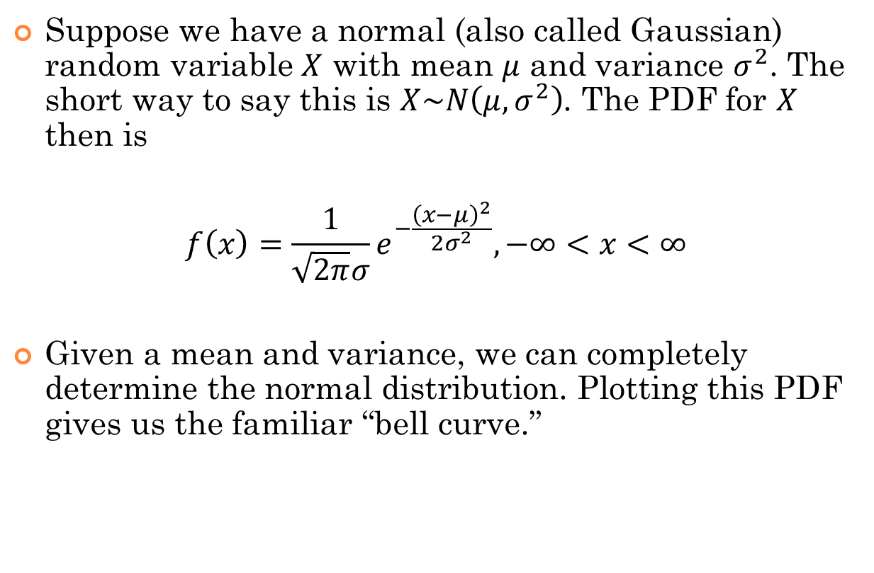
6.2 – Normal Distribution
Suppose we have a normal (also called Gaussian) random variable $X$ with mean $μ$ and variance $σ^{2}$. The short way to say this is $X\sim N\left(μ,σ^{2}\right)$. The PDF for $X$ then is
$$f\left(x\right)=\frac{1}{\sqrt{2π}σ}e^{−\frac{{\left(x−μ\right)}^{2}}{2σ^{2}}}, −∞<x<∞$$
Given a mean and variance, we can completely determine the normal distribution. Plotting this PDF gives us the familiar “bell curve.”

Slide 9
6.2 – Normal Distribution
We now demonstrate what the normal PDF looks like and how location and shape are determined by mean and variance.

Slide 10
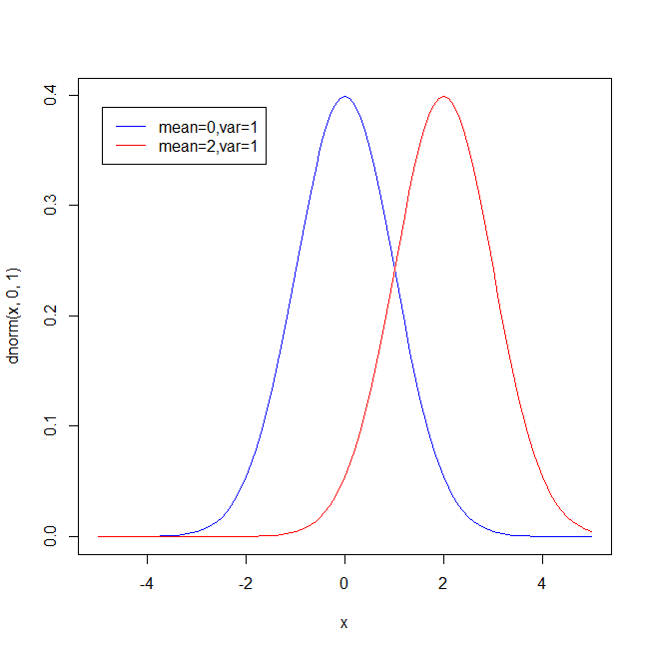
6.2 – Normal Distribution

Slide 11
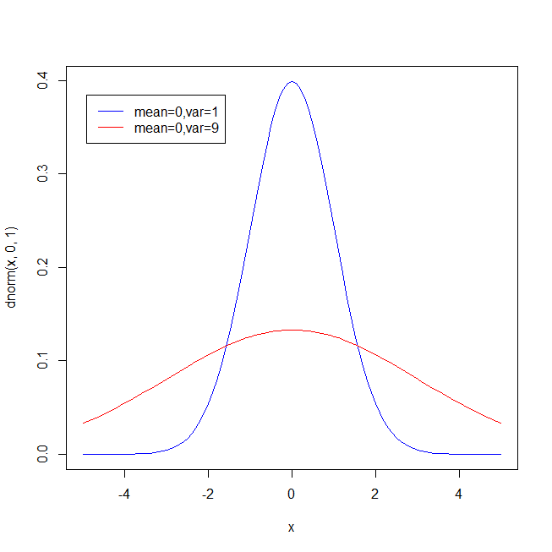
6.2 – Normal Distribution

Slide 12
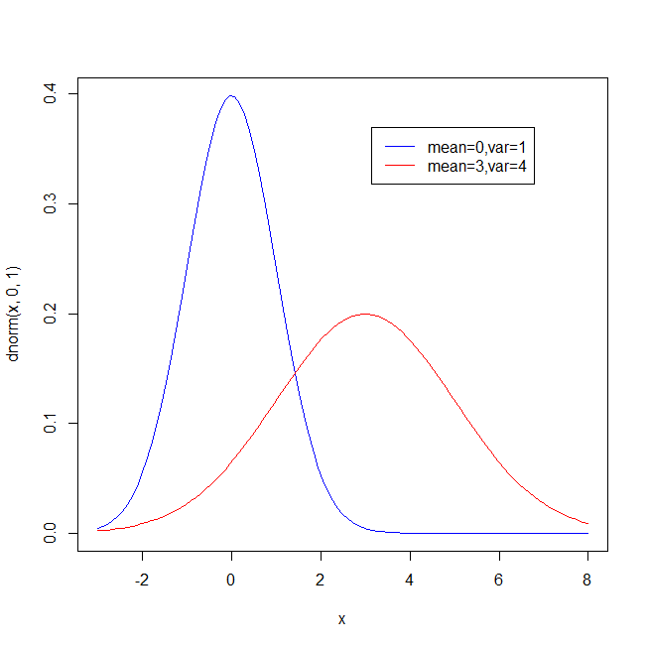
6.2 – Normal Distribution

Slide 13
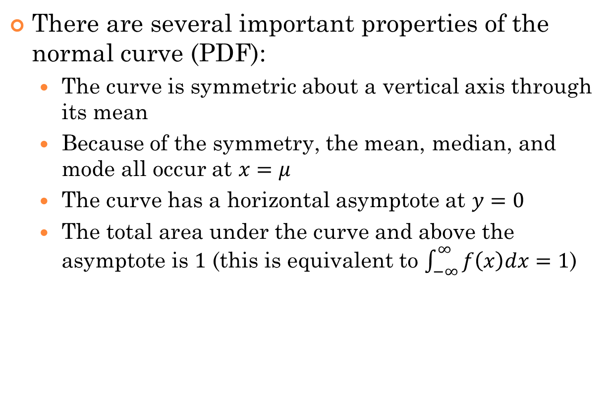
6.2 – Normal Distribution
There are several important properties of the normal curve (PDF):
  The curve is symmetric about a vertical axis through its mean
  Because of the symmetry, the mean, median, and mode all occur at $x=μ$
  The curve has a horizontal asymptote at $y=0$
  The total area under the curve and above the asymptote is $1$ (this is equivalent to $\int_{−∞}^{∞}{f\left(x\right)dx=1}$)

Slide 14
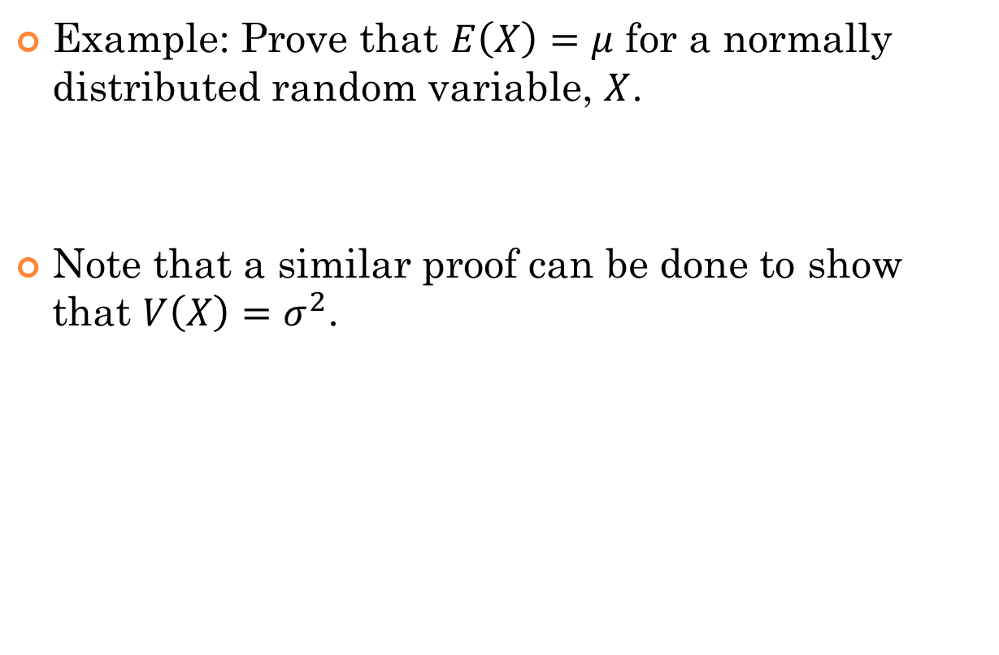
6.2 – Normal Distribution
Example: Prove that $E\left(X\right)=μ$ for a normally distributed random variable, $X$.
Note that a similar proof can be done to show that $V\left(X\right)=σ^{2}$.

Slide 15
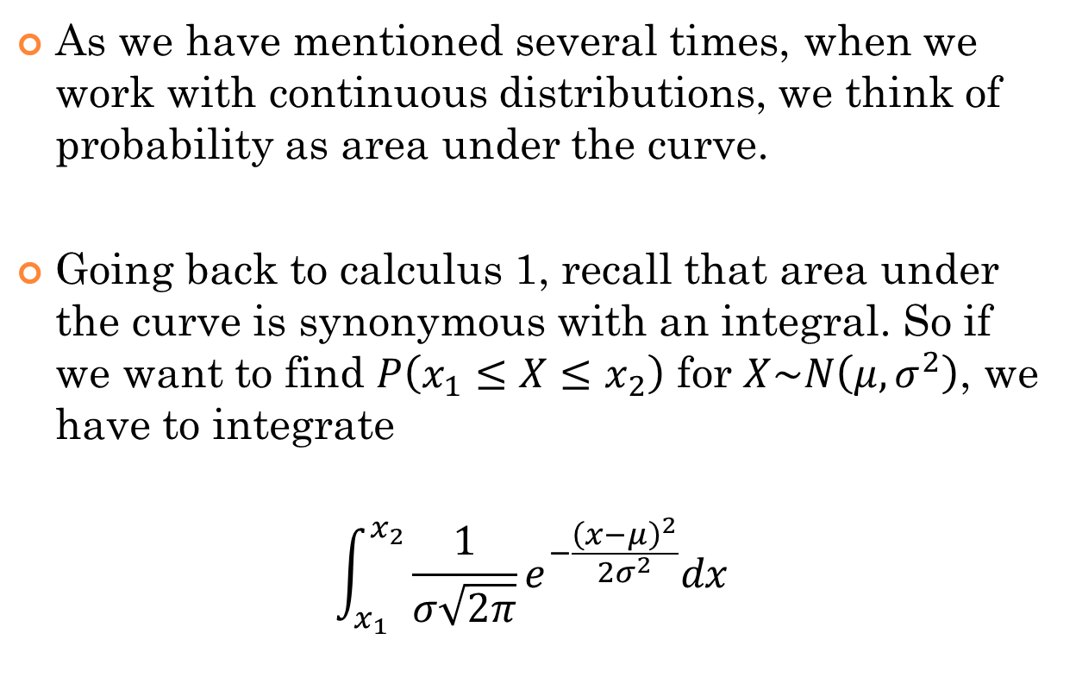
6.3 – Area under the Normal Curve
As we have mentioned several times, when we work with continuous distributions, we think of probability as area under the curve.
Going back to calculus 1, recall that area under the curve is synonymous with an integral. So if we want to find $P\left(x_{1}≤X≤x_{2}\right)$ for $X\sim N\left(μ,σ^{2}\right)$, we have to integrate
$$\int_{x_{1}}^{x_{2}}{\frac{1}{σ\sqrt{2π}}e^{−\frac{{\left(x−μ\right)}^{2}}{2σ^{2}}}dx}$$

Slide 16

6.3 – Area under the Normal Curve
Coming up with tables for every possible combination of $μ$ and $σ^{2}$ is a ridiculously hopeless task. However, there is a way to transform any normal random variable so that we only need one table.

Slide 17

6.3 – Area under the Normal Curve
Consider the random variable $Z=\frac{X−μ}{σ}$. Using this as a transformation, we can substitute this into the integral we saw previously.

Slide 18
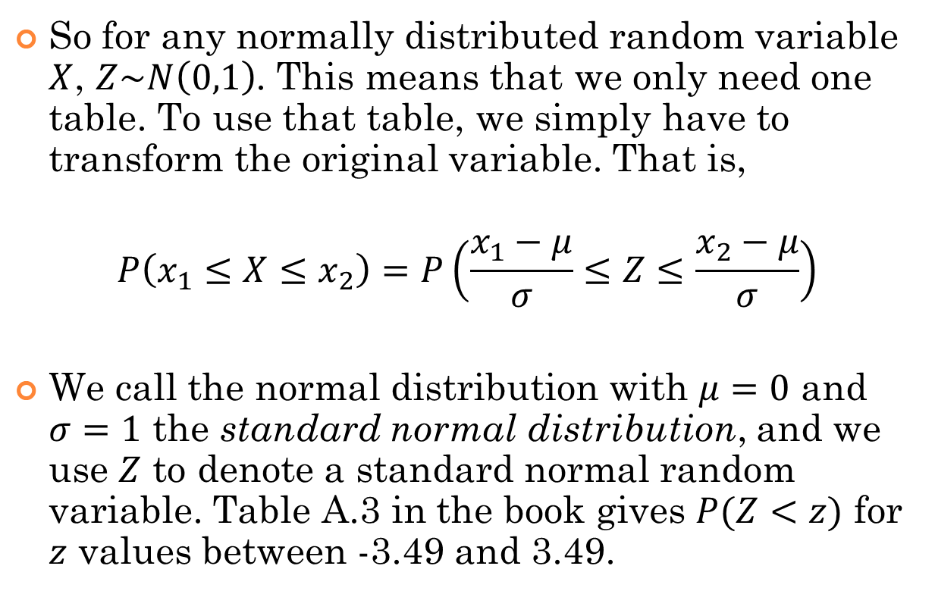
6.3 – Area under the Normal Curve
So for any normally distributed random variable $X$, $Z\sim N\left(0,1\right)$. This means that we only need one table. To use that table, we simply have to transform the original variable. That is,
$$P\left(x_{1}≤X≤x_{2}\right)=P\left(\frac{x_{1}−μ}{σ}≤Z≤\frac{x_{2}−μ}{σ}\right)$$
We call the normal distribution with $μ=0$ and $σ=1$ the standard normal distribution, and we use $Z$ to denote a standard normal random variable. Table A.3 in the book gives $P(Z<z)$ for $z$ values between -3.49 and 3.49.

Slide 19

6.3 – Area under the Normal Curve
Example: Use table A.3 to find:
  $P\left(Z<1.74\right)$
  $P(Z>−0.23)$
  $P(−0.4<Z<1.98)$

Slide 20
6.3 – Area under the Normal Curve
A note about these tables: On exams and quizzes, you will be asked to use tables. If not specifically asked, you may use the app.

Slide 21

6.3 – Area under the Normal Curve
Exercise: Suppose that $X\sim N(μ=300,σ=50)$. Find:
  $P\left(X>362\right)$
  $P\left(X<250\right)$
  $P(250<X<350)$

Slide 22
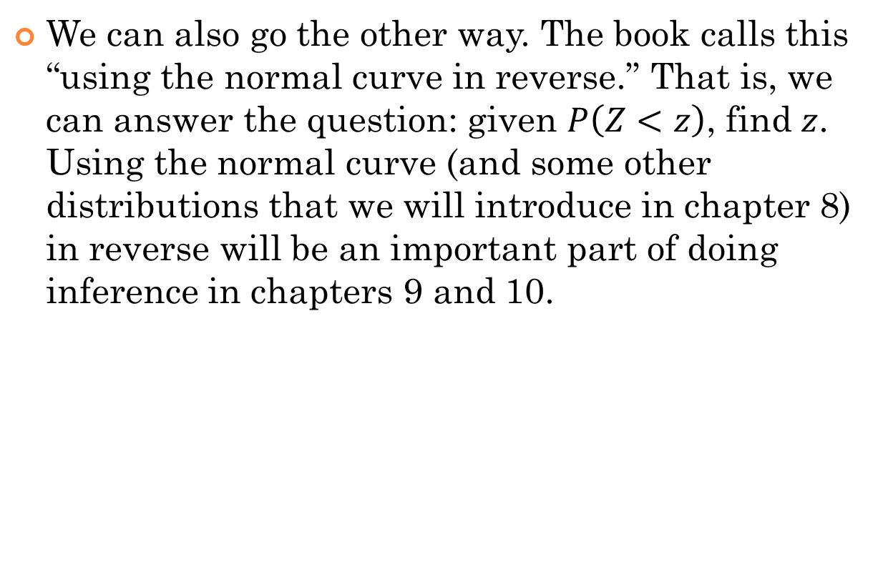
6.3 – Area under the Normal Curve
We can also go the other way. The book calls this “using the normal curve in reverse.” That is, we can answer the question: given $P\left(Z<z\right)$, find $z$. Using the normal curve (and some other distributions that we will introduce in chapter 8) in reverse will be an important part of doing inference in chapters 9 and 10.

Slide 23

6.3 – Area under the Normal Curve
Example: Find $z$ such that:
  $P\left(Z>z\right)=0.0322$
  $P\left(Z<z\right)=0.3707$
  $P\left(−z<Z<z\right)=0.90$
  $P\left(0<Z<z\right)=0.3577$

Slide 24
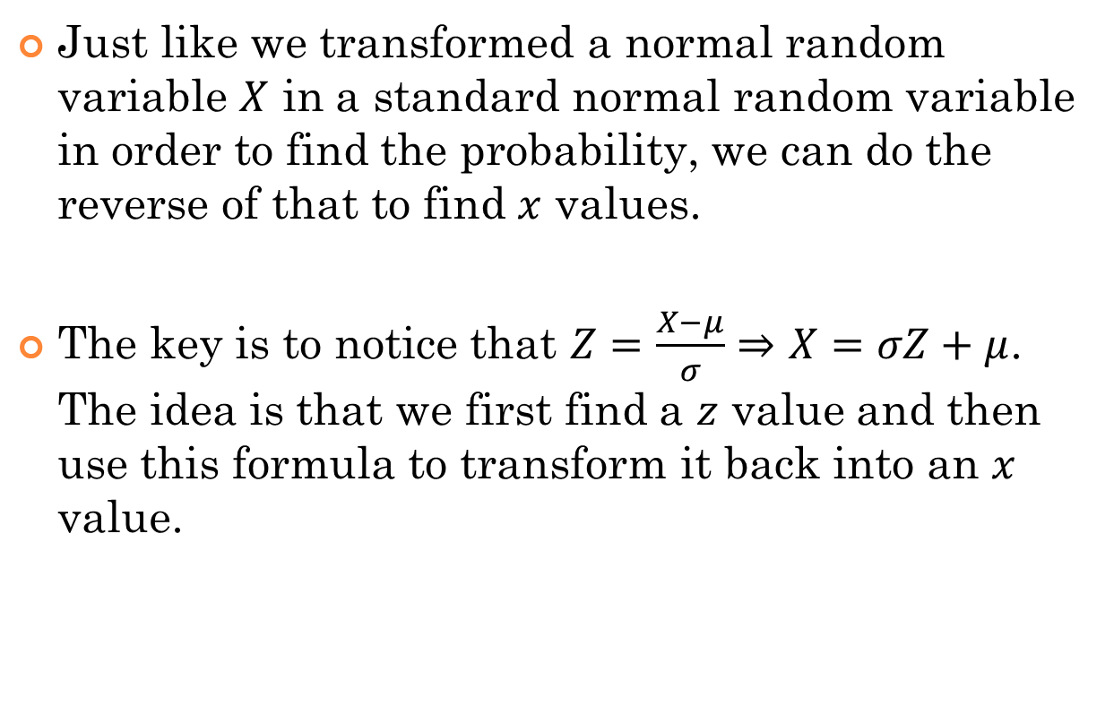
6.3 – Area under the Normal Curve
Just like we transformed a normal random variable $X$ in a standard normal random variable in order to find the probability, we can do the reverse of that to find $x$ values.
The key is to notice that $Z=\frac{X−μ}{σ}⇒X=σZ+μ$. The idea is that we first find a $z$ value and then use this formula to transform it back into an $x$ value.

Slide 25

6.3 – Area under the Normal Curve
Exercise: Assume $X\sim N(μ=30, σ=6)$. Find $x$ such that:
  $P\left(X<x\right)=0.80$
  $P\left(X>x\right)=0.15$
  $P\left(x_{1}<X<x_{2}\right)=0.75$

Slide 26
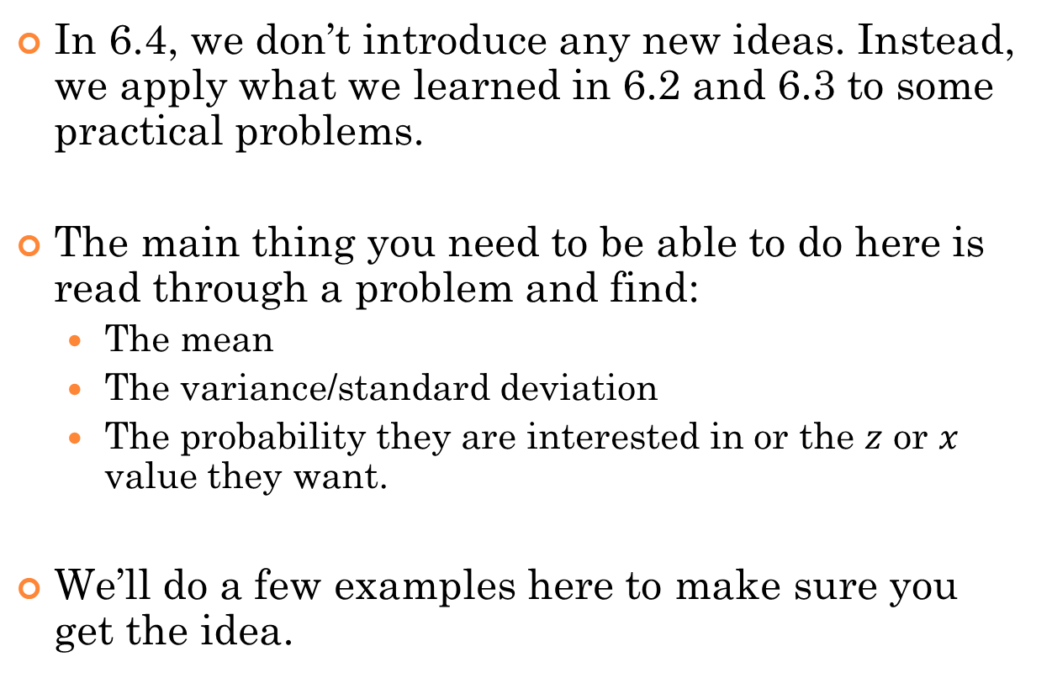
6.4 – Applications of the Normal Distribution
In 6.4, we don’t introduce any new ideas. Instead, we apply what we learned in 6.2 and 6.3 to some practical problems.
The main thing you need to be able to do here is read through a problem and find:
  The mean
  The variance/standard deviation
  The probability they are interested in or the $z$ or $x$ value they want.
We’ll do a few examples here to make sure you get the idea.

Slide 27
6.4 – Applications of the Normal Distribution
Example: A certain type of storage battery lasts, on average, 3 years with a standard deviation of 0.5 years. Assuming that the battery life is normally distributed, find the probability that a given battery will last less than 2.3 years.

Slide 28

6.4 – Applications of the Normal Distribution
Here we have $X\sim N\left(μ=3, σ=0.5\right)$. To find $P(X<2.3)$, we use a standard normal distribution. That is:
$$P\left(X<2.3\right)=P\left(Z<\frac{2.3−3}{0.5}\right)=P\left(Z<−1.4\right)=0.081$$

Slide 29
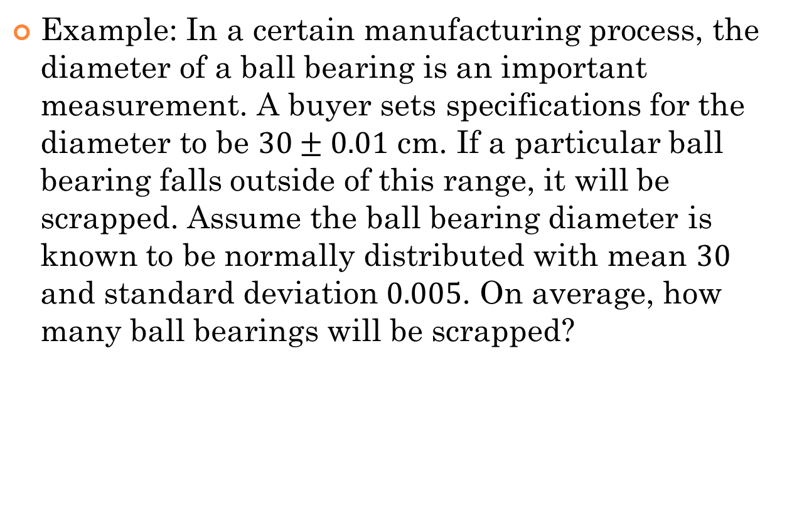
6.4 – Applications of the Normal Distribution
Example: In a certain manufacturing process, the diameter of a ball bearing is an important measurement. A buyer sets specifications for the diameter to be $30±0.01$ cm. If a particular ball bearing falls outside of this range, it will be scrapped. Assume the ball bearing diameter is known to be normally distributed with mean $30$ and standard deviation $0.005$. On average, how many ball bearings will be scrapped?

Slide 30
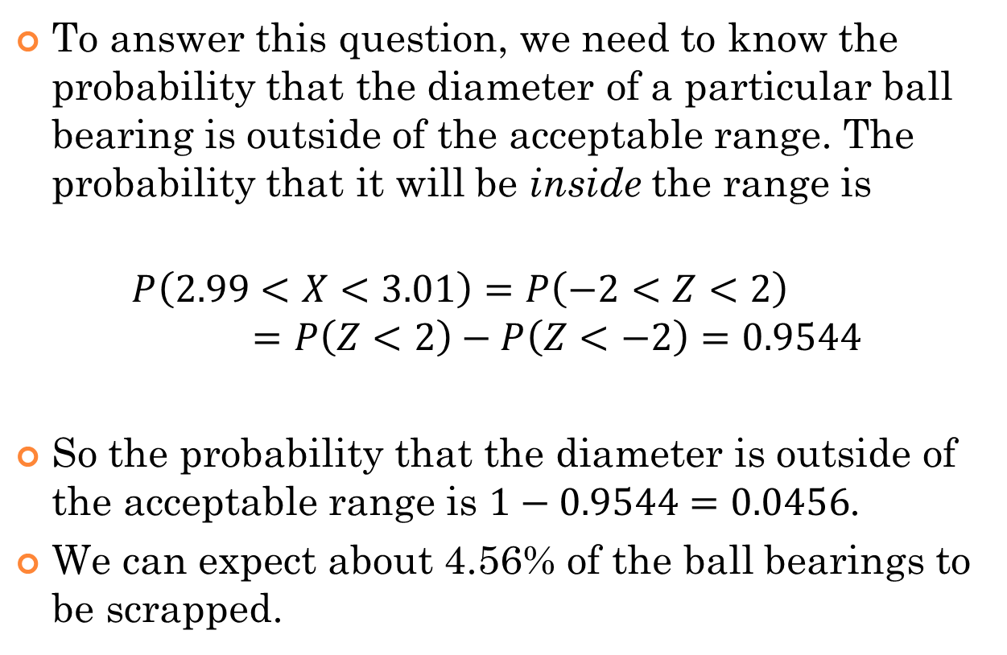
6.4 – Applications of the Normal Distribution
To answer this question, we need to know the probability that the diameter of a particular ball bearing is outside of the acceptable range. The probability that it will be inside the range is
$$P\left(2.99<X<3.01\right)=P\left(−2<Z<2\right)=P\left(Z<2\right)−P\left(Z<−2\right)=0.9544$$
So the probability that the diameter is outside of the acceptable range is $1−0.9544=0.0456$.
We can expect about 4.56% of the ball bearings to be scrapped.

Slide 31
6.4 – Applications of the Normal Distribution
Example: Suppose the average score on an exam is 74 and the standard deviation is 7. If 12% of the students receive an A and the grades are curved to follow a normal distribution, what is the lowest possible A and the highest possible B?

Slide 32
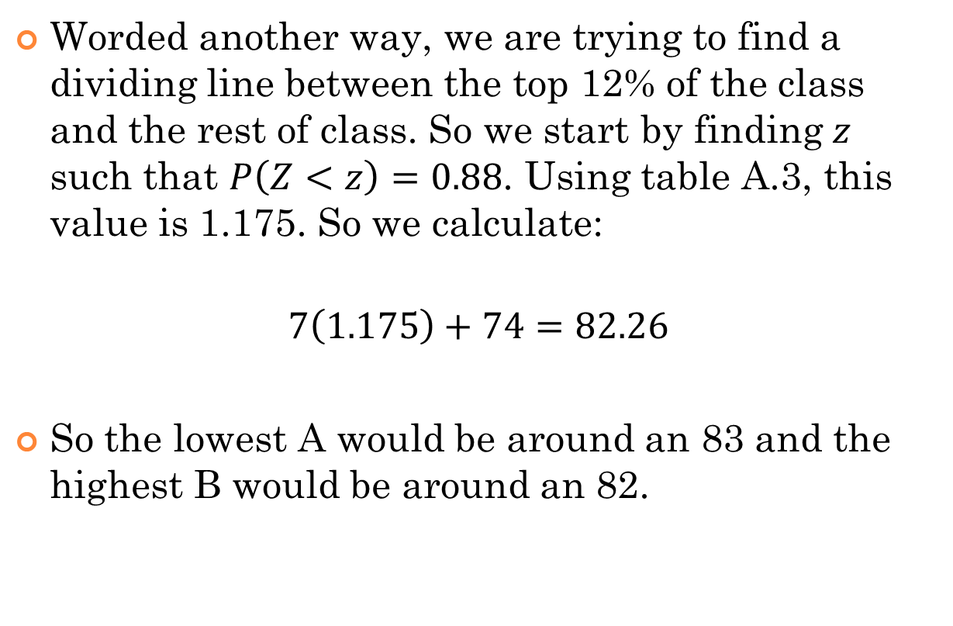
6.4 – Applications of the Normal Distribution
Worded another way, we are trying to find a dividing line between the top 12% of the class and the rest of class. So we start by finding $z$ such that $P\left(Z<z\right)=0.88$. Using table A.3, this value is 1.175. So we calculate:
$$7\left(1.175\right)+74=82.26$$
So the lowest A would be around an 83 and the highest B would be around an 82.

Slide 33
6.6 – Gamma and Exponential Distributions
While the normal distribution may be the most important, there are a number of other continuous distributions we can look at. We finish chapter 6 by looking at two of them.
The first is the gamma distribution. This has a close relation to the gamma function that you might see in a differential equations or partial differential equations class.

Slide 34
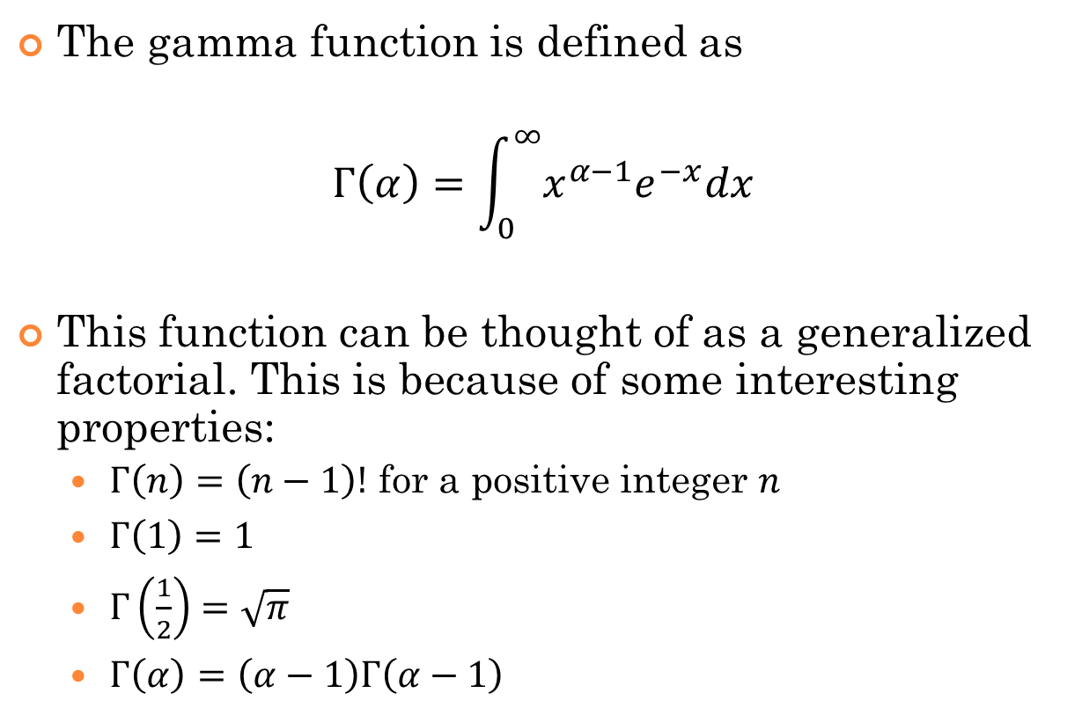
6.6 – Gamma and Exponential Distributions
The gamma function is defined as
$$Γ\left(α\right)=\int_{0}^{∞}{x^{α−1}e^{−x}dx}$$
This function can be thought of as a generalized factorial. This is because of some interesting properties:
  $Γ\left(n\right)=\left(n−1\right)!$ for a positive integer $n$
  $Γ\left(1\right)=1$
  $Γ\left(\frac{1}{2}\right)=\sqrt{π}$
  $Γ\left(α\right)=\left(α−1\right)Γ\left(α−1\right)$

Slide 35
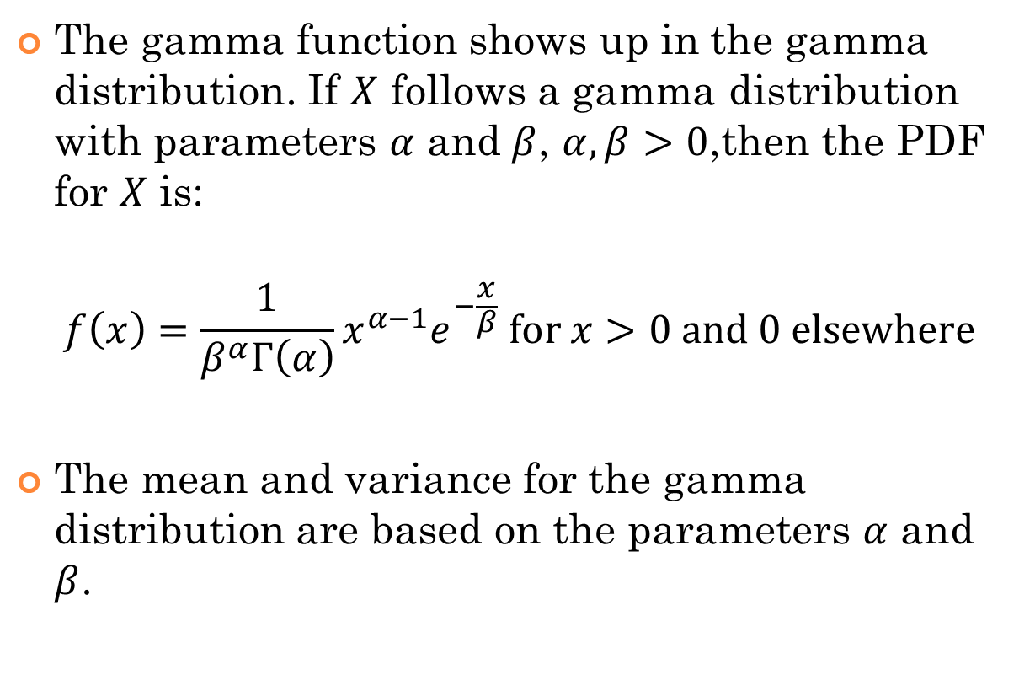
6.6 – Gamma and Exponential Distributions
The gamma function shows up in the gamma distribution. If $X$ follows a gamma distribution with parameters $α$ and $β$, $α,β>0$,then the PDF for $X$ is:
$$f\left(x\right)=\frac{1}{β^{α}Γ\left(α\right)}x^{α−1}e^{−\frac{x}{β}} for x>0 and 0 elsewhere$$
The mean and variance for the gamma distribution are based on the parameters $α$ and $β$.

Slide 36

6.6 – Gamma and Exponential Distributions
Exercise: Find the mean and variance of the gamma distribution with parameters $α$ and $β$

Slide 37
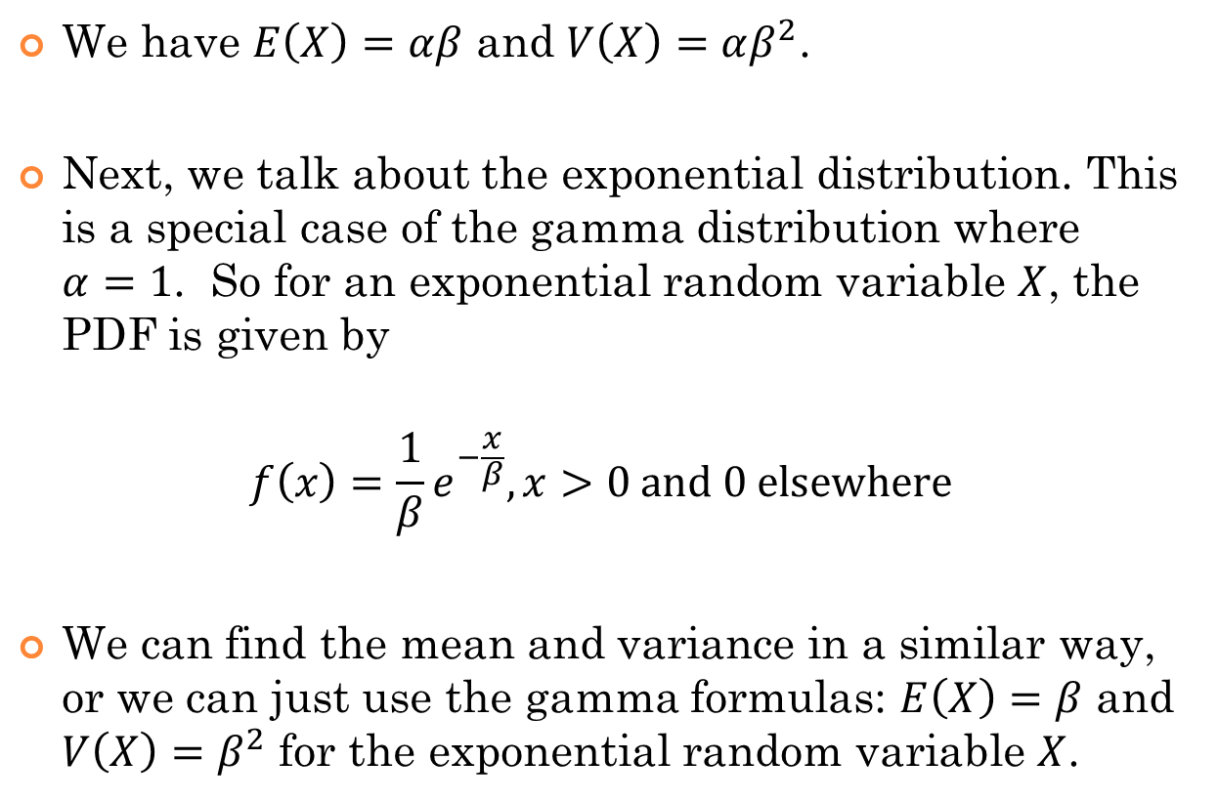
6.6 – Gamma and Exponential Distributions
We have $E\left(X\right)=αβ$ and $V\left(X\right)=αβ^{2}$.
Next, we talk about the exponential distribution. This is a special case of the gamma distribution where $α=1$. So for an exponential random variable $X$, the PDF is given by
$$f\left(x\right)=\frac{1}{β}e^{−\frac{x}{β}}, x>0 and 0 elsewhere$$
We can find the mean and variance in a similar way, or we can just use the gamma formulas: $E\left(X\right)=β$ and $V\left(X\right)=β^{2}$ for the exponential random variable $X$.

Slide 38

6.6 – Gamma and Exponential Distributions
Exercise: Find the CDF for an exponential random variable $X$ that has mean $β$.

Slide 39
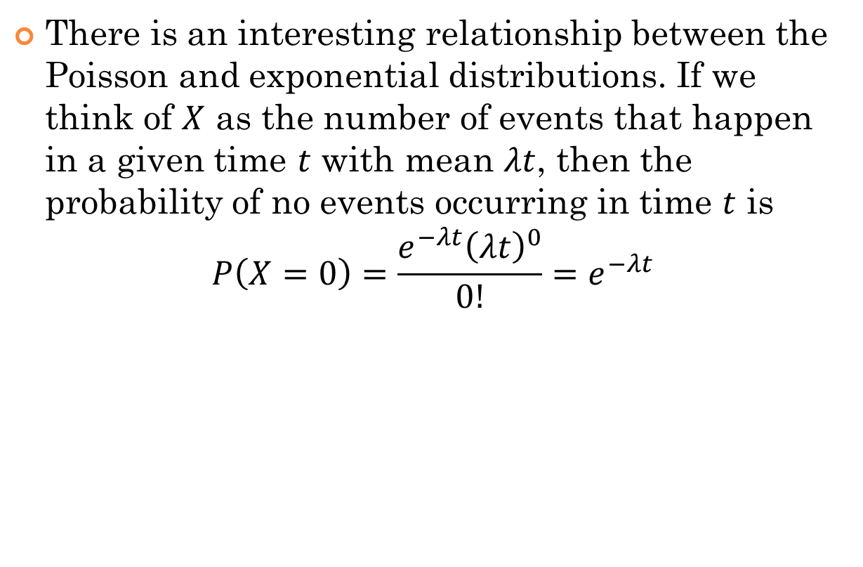
6.6 – Gamma and Exponential Distributions
There is an interesting relationship between the Poisson and exponential distributions. If we think of $X$ as the number of events that happen in a given time $t$ with mean $λt$, then the probability of no events occurring in time $t$ is
$$P\left(X=0\right)=\frac{e^{−λt}{\left(λt\right)}^{0}}{0!}=e^{−λt}$$

Slide 40
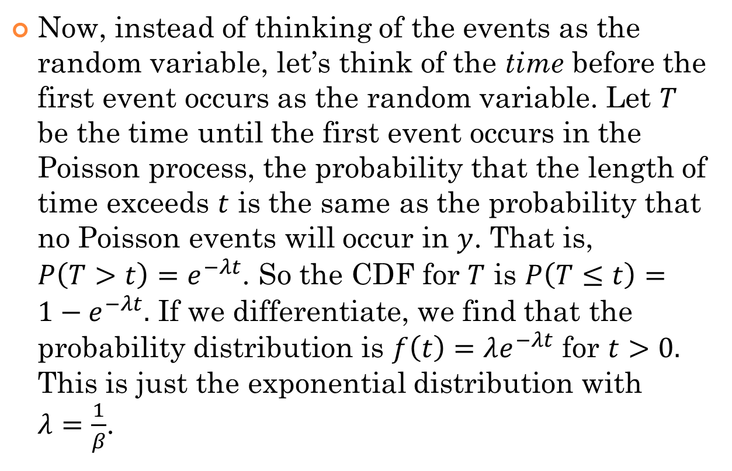
6.6 – Gamma and Exponential Distributions
Now, instead of thinking of the events as the random variable, let’s think of the time before the first event occurs as the random variable. Let $T$ be the time until the first event occurs in the Poisson process, the probability that the length of time exceeds $t$ is the same as the probability that no Poisson events will occur in $y$. That is, $P\left(T>t\right)=e^{−λt}$. So the CDF for $T$ is $P\left(T≤t\right)=1−e^{−λt}.$ If we differentiate, we find that the probability distribution is $f\left(t\right)=λe^{−λt}$ for $t>0.$ This is just the exponential distribution with $λ=\frac{1}{β}$.

Slide 41
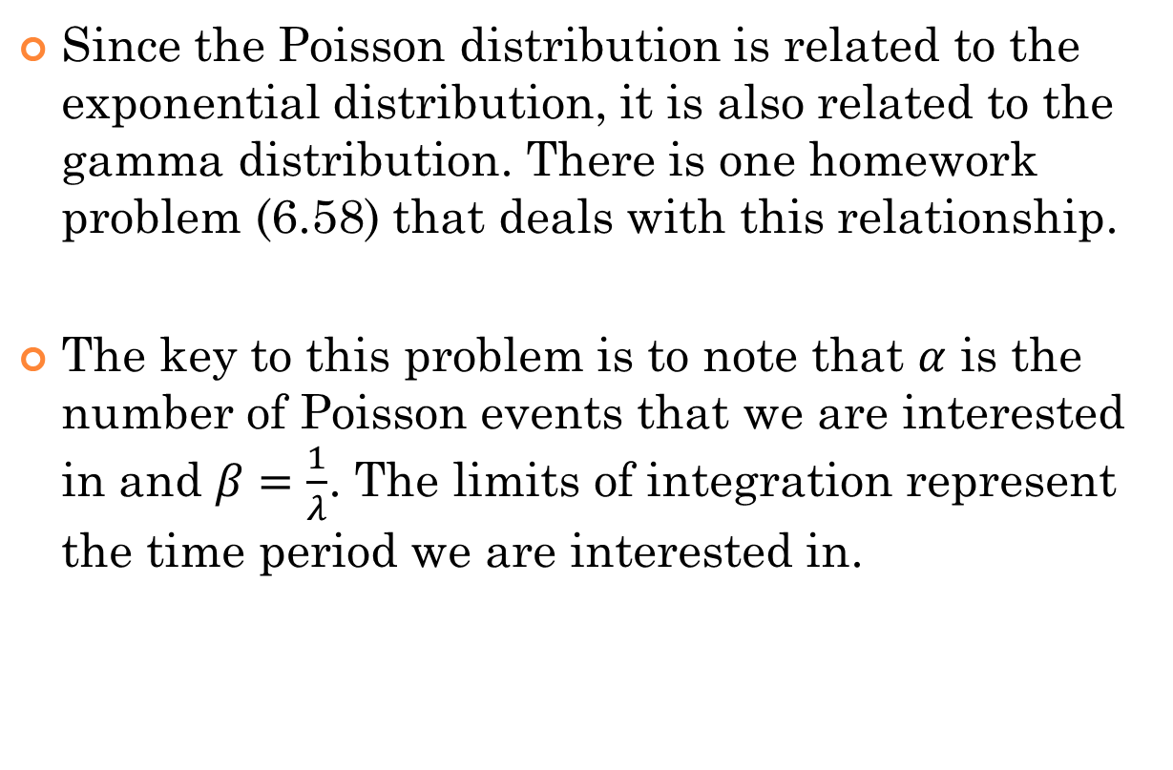
6.6 – Gamma and Exponential Distributions
Since the Poisson distribution is related to the exponential distribution, it is also related to the gamma distribution. There is one homework problem (6.58) that deals with this relationship.
The key to this problem is to note that $α$ is the number of Poisson events that we are interested in and $β=\frac{1}{λ}$. The limits of integration represent the time period we are interested in.

